Slide 1
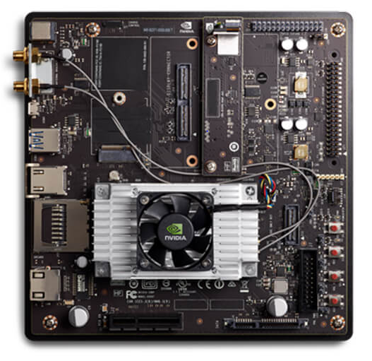
Hardware
170mm
DC power
Camera
Antenna terminal
Micro USB type A & B
USB 3.0 type A
170mm
HDMI
SD card reader
Reset
User Definable
Recovery
Power
Ethernet cable
Jetson TX2 module
PCIe Connector
SATA Data & Power connector

